Slide 1
 | KYOKKO | Viking | Freja | HILAT | Polar Bear
Launch data | 1978 | 1986 | 1992 | 1983 | 1986
Semi-major axis(km) |  | 13550 |  |  | 7360
Eccentricity |  | 0.0001538 |  | 0.00018
Perigee(km) | 630 | 801 | 601 | 828.20 | 959.8
Apogee(km) | 3790 | 13538 | 1756 | 830.80 | 1019.4
Inclination(°) | 65 | 98.7863 | 63.0 | 82.2 | 89.5
Period(min) | 134 | 261.56 | 109 | 101.50 | 104.7
Aurora observation | Auroral Imager | Auroral Imager | F5 auroral imager | Auroral/Ionospheric Mapper (AIM) | Auroral Ionospheric Remote Sensor (AIRS)
Data |  | 1986-1987 (http://data.phys.ucalgary.ca/sort_by_project/other/VIKING/) | 1992-1996 (F5 image access forbidden)
Data product

Slide 2
 | DE-1 | DMSP/SSUSI | TIMED | IMAGE
Launch data | 1981 | 2003 | 2001 | 2000
Semi-major axis(km) | 18238.0 | Re+850km | 6983.0
Perigee(km) | 488.6 km | 843 | 611.7 | 1000
Apogee(km) | 23246.3 km | 853 | 612.6 | 45922
Inclination(°) | 89.959 | 98.9 | 74.07
Period(min) | 408.5 | 102 | 96.8 | 14.2 h
Instrument | Spin-scan Auroral Imager (SAI) | Special Sensor Ultraviolet Spectrographic Imagers (SSUSI) | Global Ultraviolet Imager (GUVI) | FUV
Image data | 1981-1991 | 2003-2019 (https://ssusi.jhuapl.edu/data_availability) | 2002-2019 (http://guvitimed.jhuapl.edu/data_products) | 2000-2005
Data product |  | Aurora Data; electron and ion particle fluxes from SSJ; ion drift from IDM | Aurora Data; Thermospheric O/N₂; O/N₂ and TEC ; Electron Density Profile

Slide 3
国家 | 美国 | 欧空局 | 美国 | 美国 | 加拿大 | 美国 | 美国
遥感载荷 | 平流层气溶胶和气体实验(SAGE III) | 多光谱推 扫成像仪 (REIS) | 可见光/ 近红外高光谱成像仪(HICO) | 高层大气和电离层探测系统 (RAIDS) | 高光谱遥感载荷 (HRS) | 便携式低照度海洋观测高光谱成像仪(PHILLS) | 农业相机 (AgCam)
应用 | 大气 | 农业 | 海洋 | 大气 | 多种 | 海洋 | 农业
谱段/nm | 283~1030 | 440~850, 5个谱段 | 380~1000 | 50~874 | 400~2500 | 400~1000 | 630~690，780~890
空间分辨率 | 1~2km | 4m | 100m | 3km | 30/40m | 25m | 10m
光谱分辨率/nm | 1~2 | 40~90 | 5 | 1.5/ 40~120 | 9~12 | 10 | 60/110
 | ISS/RAIDS
Launch data | 1998
Perigee(km) | 408
Apogee(km) | 410
Inclination(°) | 51.64
Period(min) | 92.68
Instrument | EUV Spectrograph, FUV Spectrograph, MUV Spectrometer, NUV Spectrometer; NIR Spectrometer; photometers

Slide 4
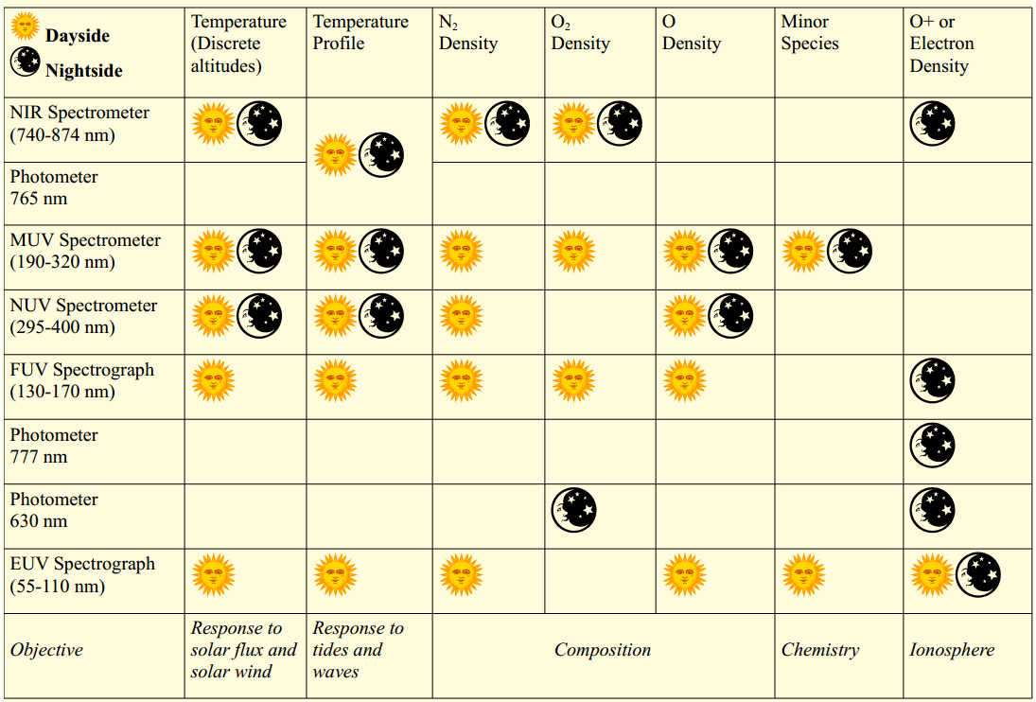
Mission Objectives, Measurements, and Sensors

Slide 5
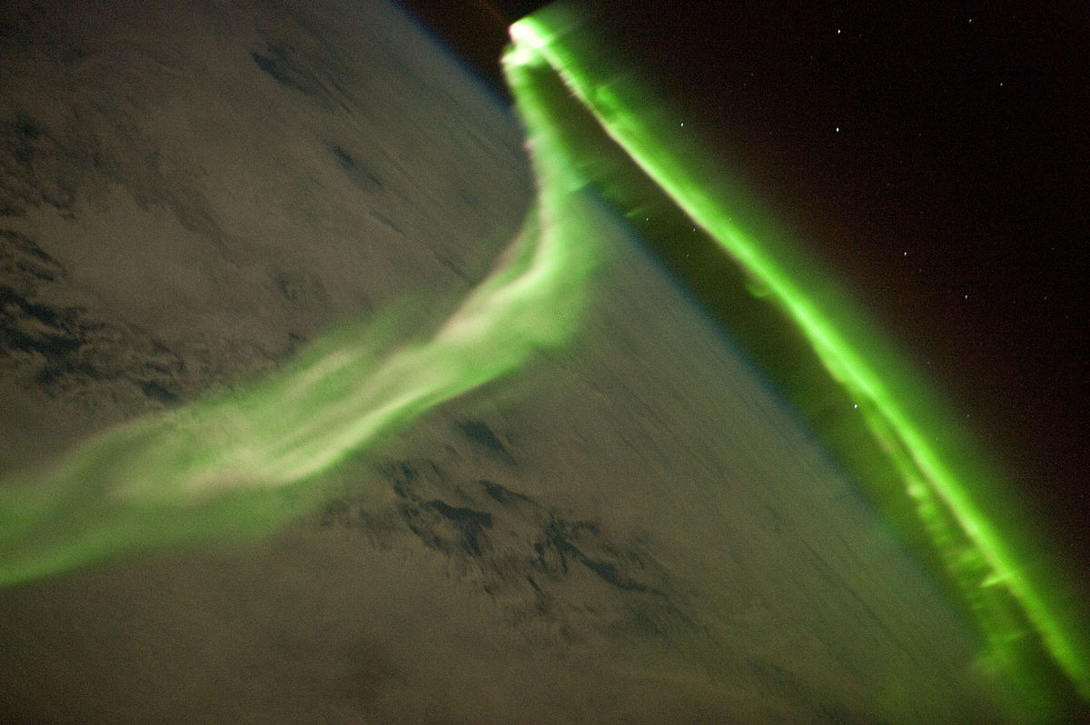
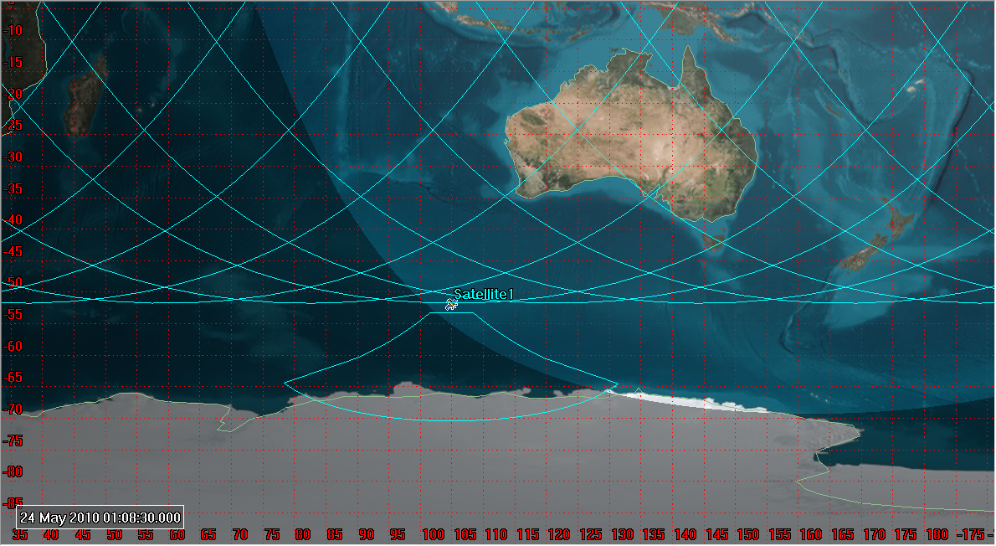
This striking aurora image was taken during a geomagnetic storm that was most likely caused by a coronal mass ejection from the Sun on 24 May 2010. The ISS was located over the Southern Indian Ocean at an altitude of 350 kilometres, with the observer most likely looking towards Antarctica (not visible) and the South Pole.

Slide 6
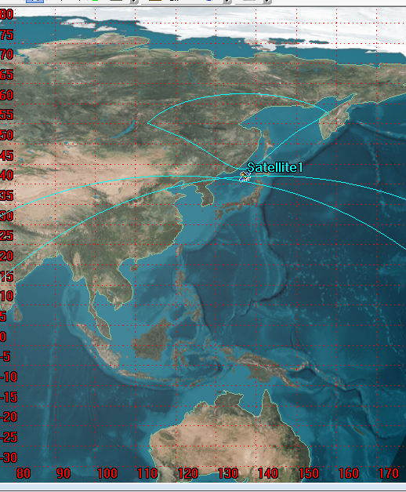
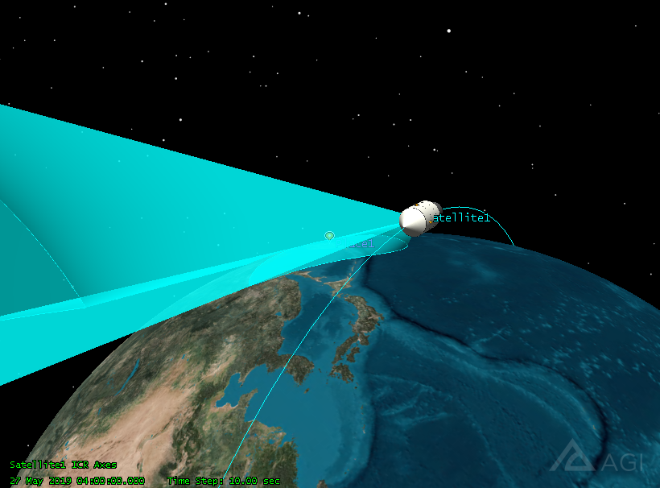
 | Chinese Space Station
Launch data
Altitude(km) | 340~450
Inclination(°) | 41~42
Period(min) | 90
Instrument

